Slide 1
Semiconductor Optimization
Pirmin Fontaine
Elena Gräfenstein
Andreas Kirsch
Christina Maier
Daniel Opritescu
Nicole Wochatz

Slide 2
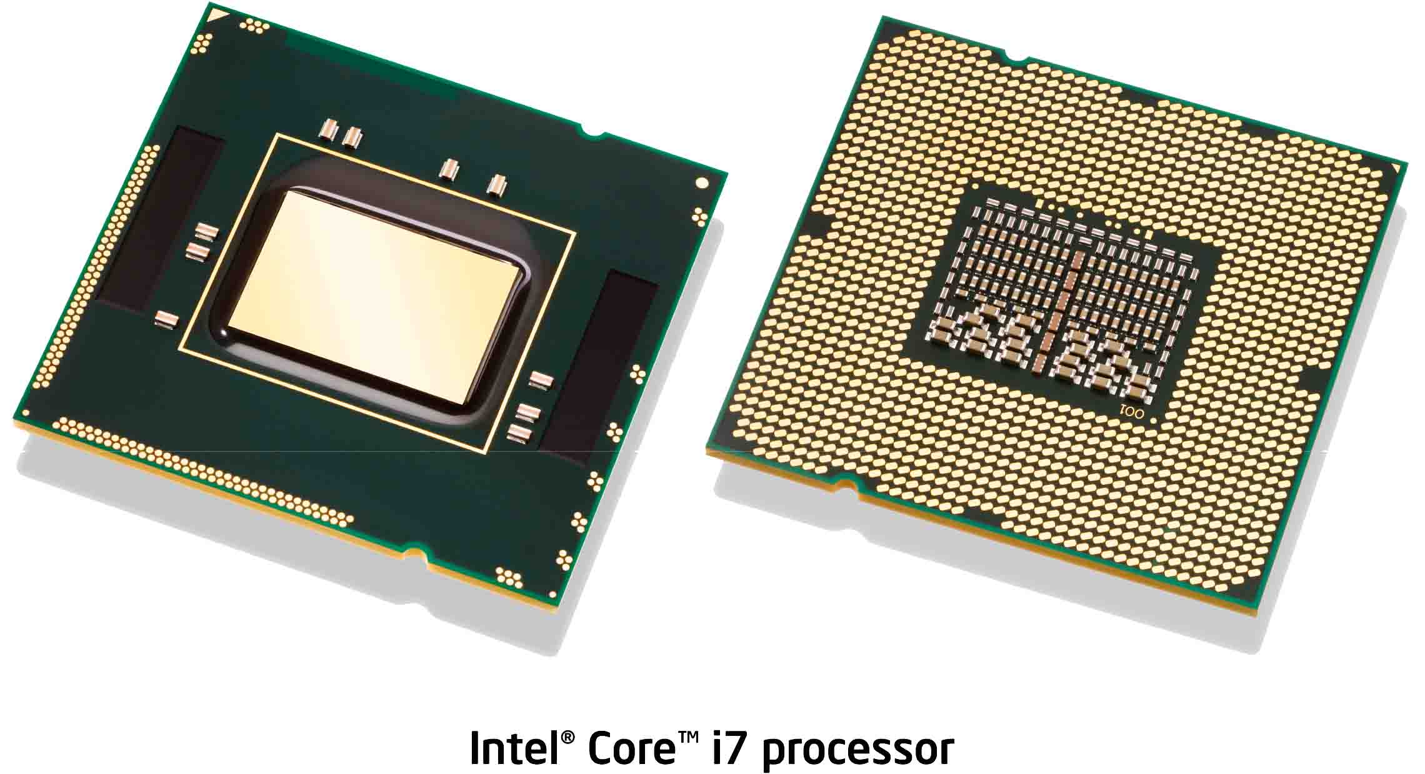
What are Semiconductors?
Courtesy of Intel Inc.

Slide 3
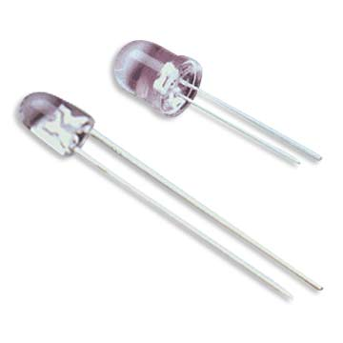
What are Semiconductors?
Semiconductors are conductors that only conduct electric current in one direction.
An LED is a semiconductor

Slide 4
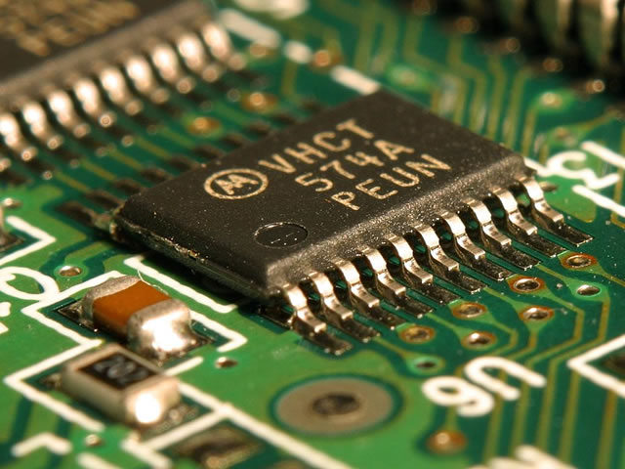
What are Semiconductors?
Usually though one refers to something more advanced:
  Chips

Slide 5
Chips
They are an important component of most modern inventions...

Slide 6
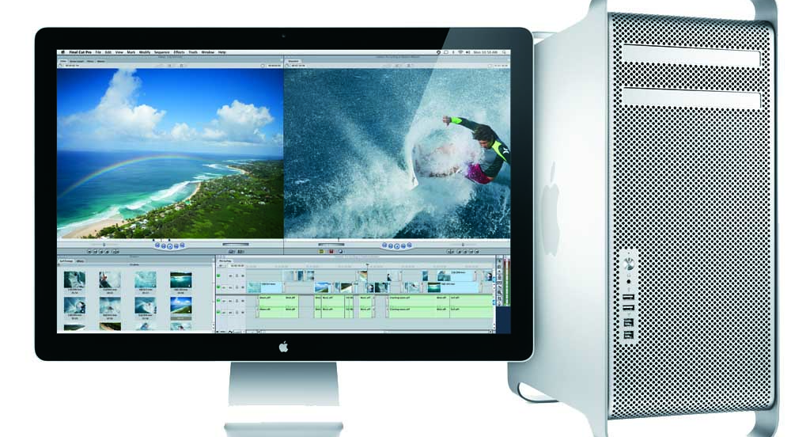
Chips
Courtesy of Apple, Inc.
… computers, of course

Slide 7

Chips
Courtesy of Apple
… mobile phones

Slide 8
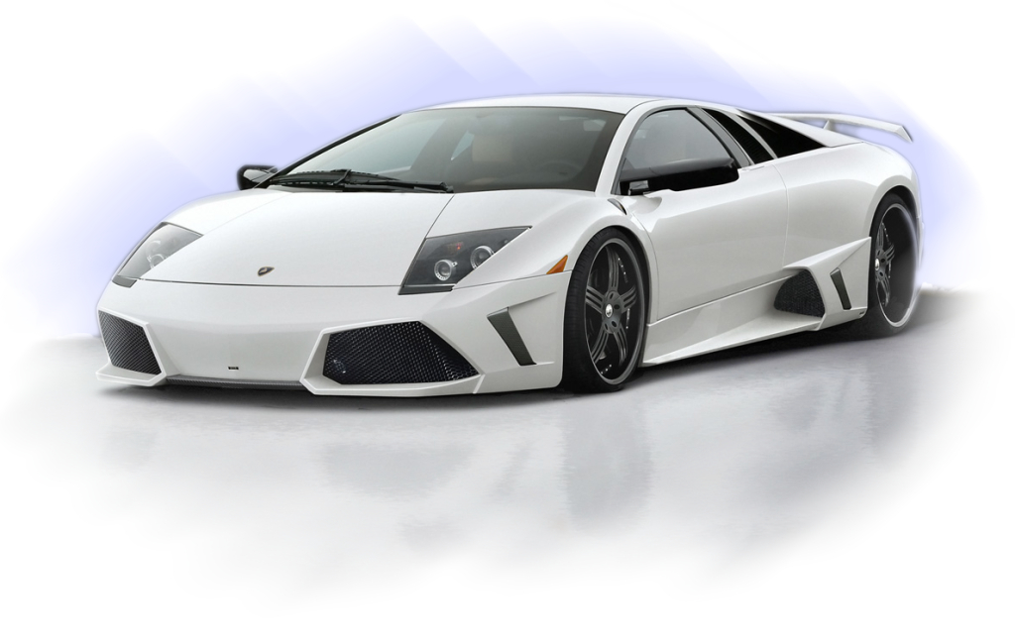
Chips
Courtesy of Lamborghini
… cars

Slide 9
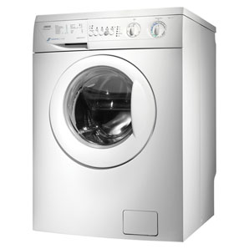

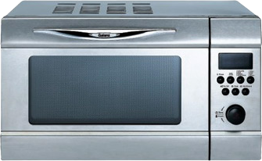
Chips
… and lots of other modern products

Slide 10
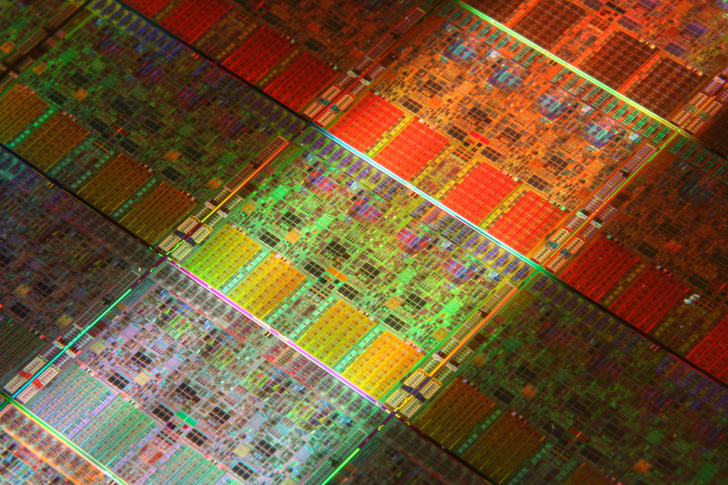
Internal Structure of a Chip
Courtesy of Intel Inc.

Slide 11
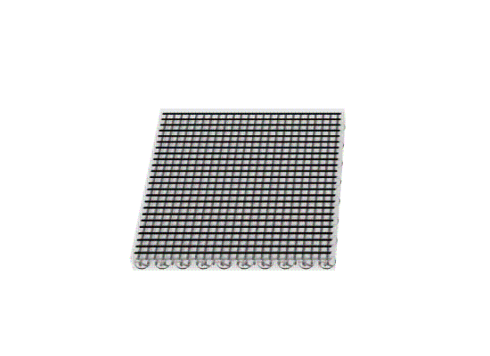
Internal Structure of a Chip
Chips are made up of lots of layers.
The bottom most layer contains switching elements called transistors.
The remaining layers contain the wiring required for interconnecting all the transistors.

Slide 12
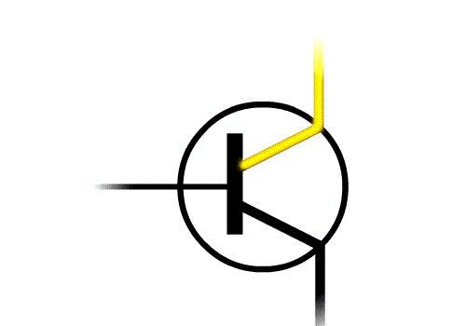
Transistors
Transistors are very basic semiconductors that allow an electric current to pass or not depending on a controlling voltage.

Slide 13
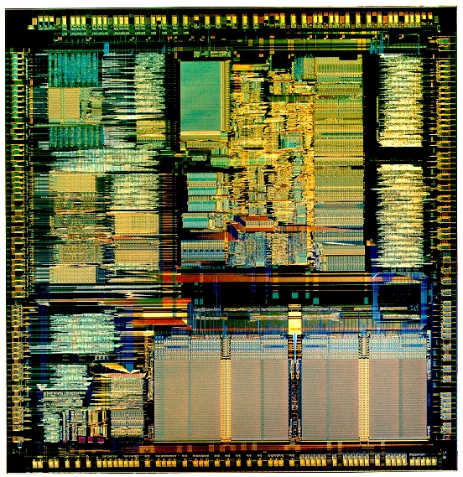
Transistors
Chips contain billions of these little transistors.
Wired together cleverly they make up all the control logic of computers, mobile phones, etc..

Slide 14
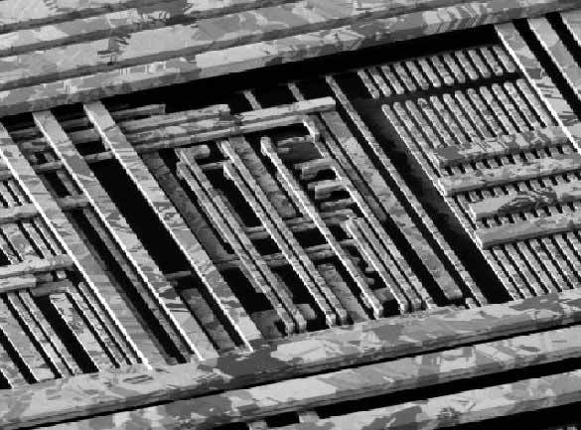
Wiring
The wiring layers interconnect different transistors. Because there are so many different connections multiple layers are needed.

Slide 15

Wiring
For technical reasons the wires on one layer have to be parallel to each other. Only the size of the gap between them can be varied.

Slide 16
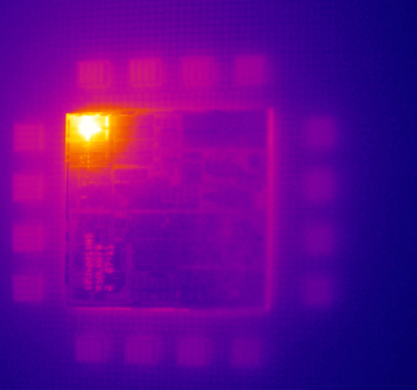
Heat
Transistors always lose energy when their state changes. This energy is directly converted into heat.
Courtesy of IBM
Infrared Image of an IBM chip

Slide 17
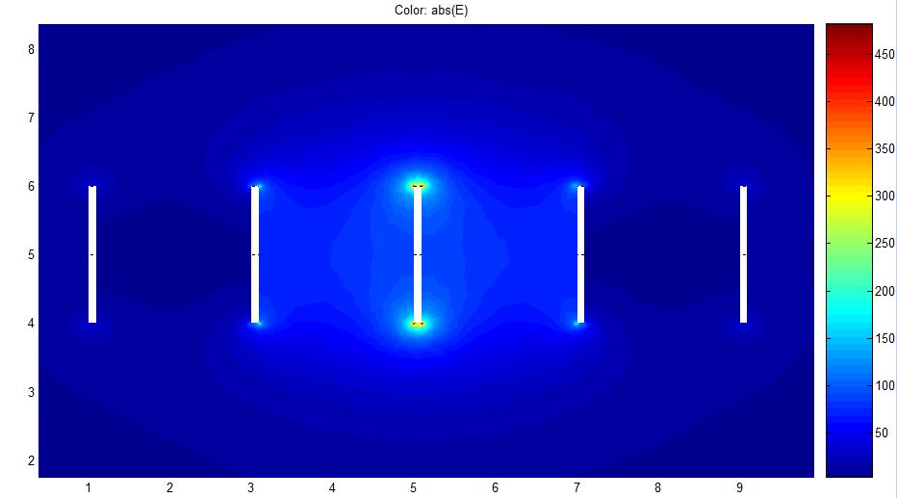
Heat
Moreover every time the current on a wire changes, its electric field is changed, too. This also causes an energy loss and heat emission.
Created with MatLAB
Strength of the Induced Electromagnetic Field

Slide 18
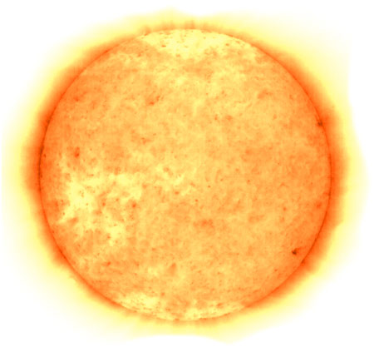
Magnitude of the Heat Problem

Slide 19
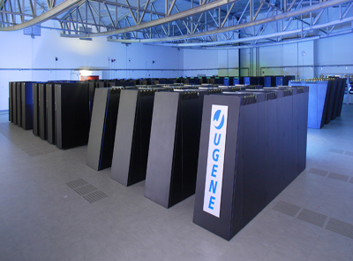
Energy Consumption
Supercomputers don’t do anything else but processing data and most of the energy is directly converted into heat as unwanted by-product.
Courtesy of Jülich Forschungszentrum

Slide 20
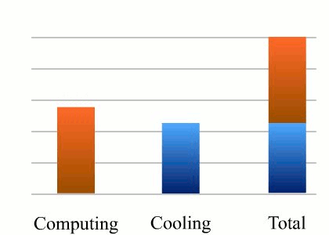
Cooling
Energy Consumption:
Up to 45% of the energy consumption is needed by the cooling equipment to keep super-computers at working temperatures.

Slide 21
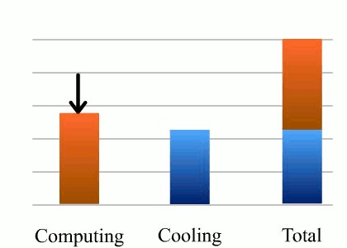
Optimization is Imperative
Energy Consumption:
Thus it is very important to reduce the energy consumption and consequently the amount of cooling needed.

Slide 22
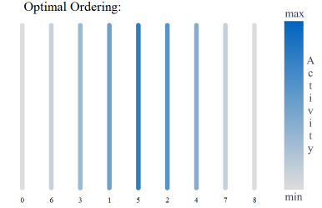
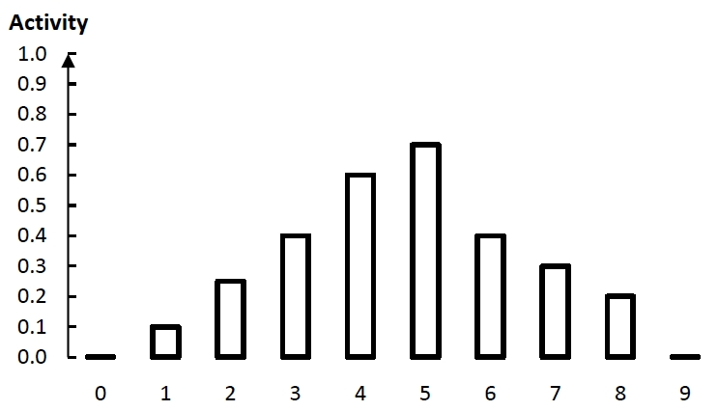
Optimization Methods

Slide 23
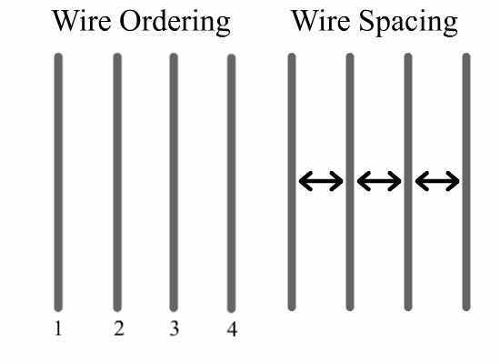
What do we optimize?
The point of attack we chose was the wiring of the transistors.
Changing the ordering and spacing of wires doesn’t require changes to the underlying design of the transistor layer itself.
Two separate problems to solve:
  Wire Ordering
  Wire Spacing

Slide 24

Idea for Wire Spacing Optimization
The further apart two wires are the less heat is emitted because of electric induction when one of the wires switches.
Heat is emitted from switching wires

Slide 25

Idea for Wire Spacing Optimization
If two wires are very active, that is switch a lot, it would be better to increase the distance between them.

Slide 26
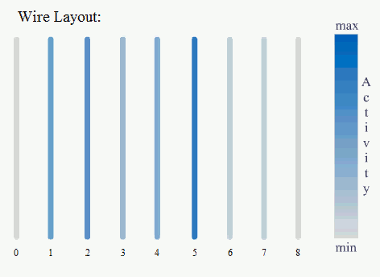
Wire Spacing
If we use the combined activity of two neighboring wires as a hint for the distribution of the space between wires, we find the optimal solution.

Slide 27
Wire Ordering
Arranging the wires with increasing activity towards the center wire yields the optimal wire ordering.

Slide 28
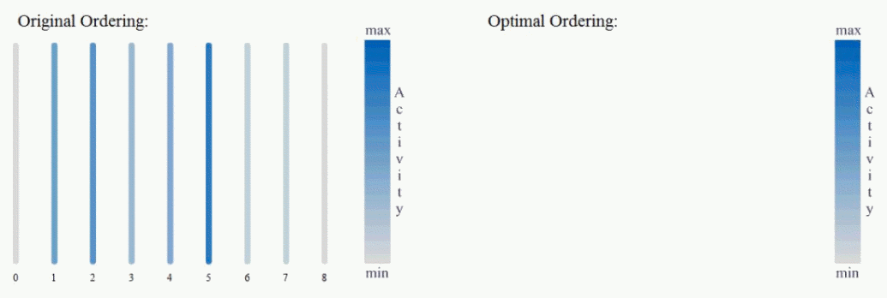
Wire Ordering

Slide 29

Outlook
Special algorithms can be developed that deal with additional information like groups of wires that always switch at the same time or with a certain probability.

